Slide 1


Department of ICT
A project defense on:
“Phishing URL detection using ML”
Project Members:
Sushil Paudel 200348
Prakash Lamichhane 200323
Bibek Pandeya 200311
Bhushan Bartaula 200310
Submitted to:
Department of ICT
Cosmos College of Management and Technology
Date : 2 July, 2025

Slide 2
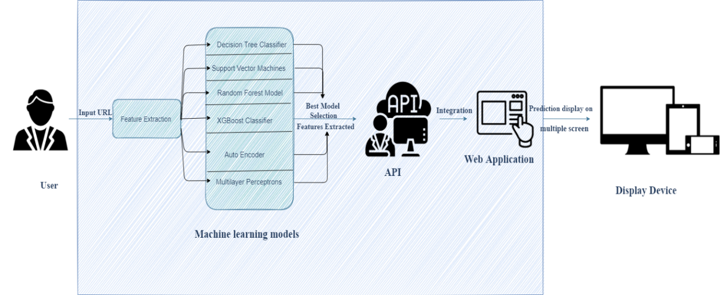
Introduction
Phishing is a social engineering (a type of attack used to steal user data, including login credentials and credit card numbers) as a type of attack that is one of the most common social engineering attacks. The attack happens when an attacker fools a victim into opening an email, instant message, or text message as if it were from a trusted source.

Slide 3
Problem Statement
Increased Vulnerability to Cyber Attacks
Delayed Response to Breaches
Inability to Detect Anomalous Behavior
Increased Risk of Data Exfiltration

Slide 4

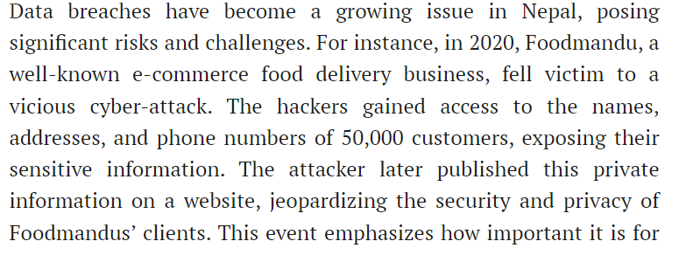
Some real incidents in Nepal:

Slide 5

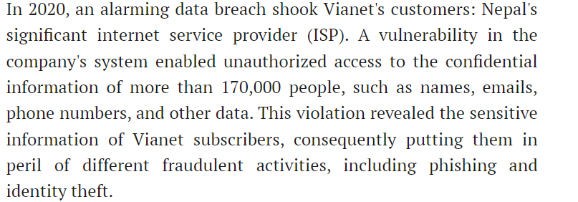
Some real incidents in Nepal:

Slide 6

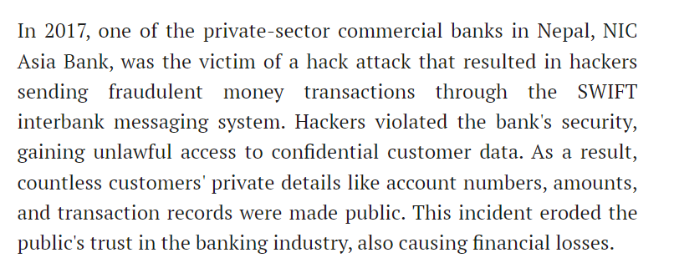
Some real incidents in Nepal:

Slide 7
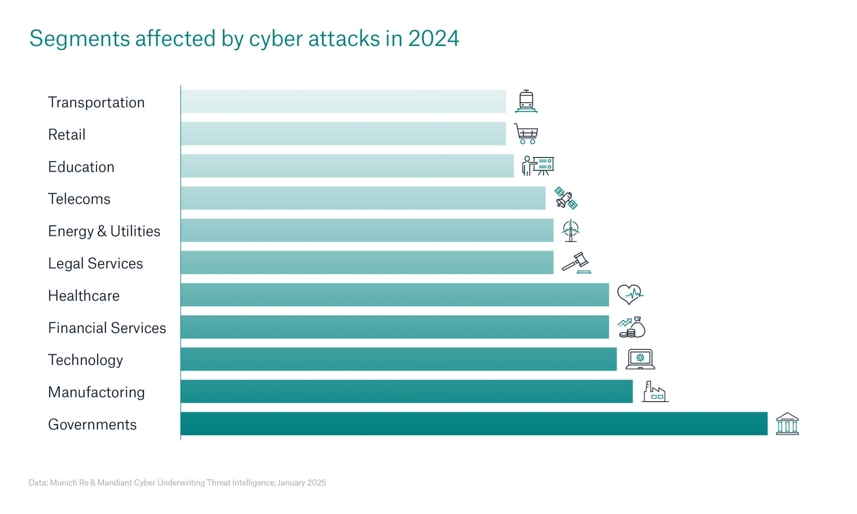
Latest statistics

Slide 8
Objectives:
To develop and deploy a lightweight executable agent (.exe) on all company devices that continuously collects and transmits system and user activity logs to a centralized server.
To implement an AI/ML-based anomaly detection model that analyzes the collected logs in real-time to identify potential security threats or abnormal behavior.
To design an admin dashboard that displays detected threats, generates reports, and provides real-time alerts for efficient threat monitoring and response.

Slide 9
Scope and Limitations:
System Activity Monitoring
Centralized Log Management
AI/ML-Based Anomaly Detection
Real-Time Alerting & Dashboard Reporting
Deployment Across Multiple Devices
Platform Dependency
Basic Log Collection Only
Limited Offline Support
Anomaly Detection Accuracy
Security Concerns
Scalability Constraints

Slide 10
Literature Review Summary
Dr. Anil Kumar Yadav (India, 2020)Demonstrated how unsupervised ML techniques can effectively detect anomalies in system logs.
Dr. Sushil Bhatta (Nepal, 2019)Emphasized real-time telemetry collection from endpoints. As per them, they implement this using lightweight agents to push live data to the server.
Ravi Kumar (India, 2021)Highlighted how centralized logging enhances threat detection speed.
Dr. Priya Sharma (India, 2018)Advocated for automated alerts and threat responses to minimize damage.

Slide 11
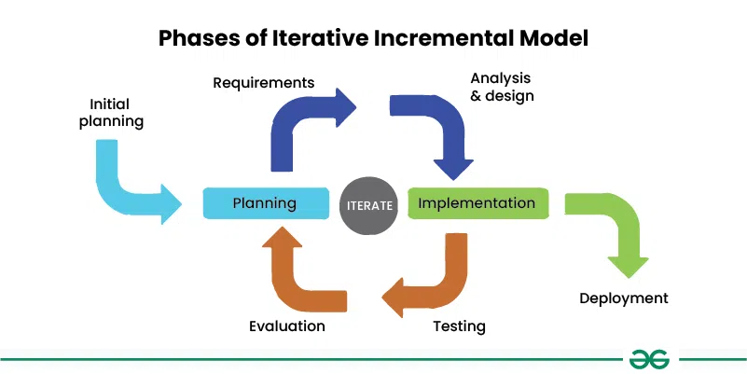
Methodology

Slide 12
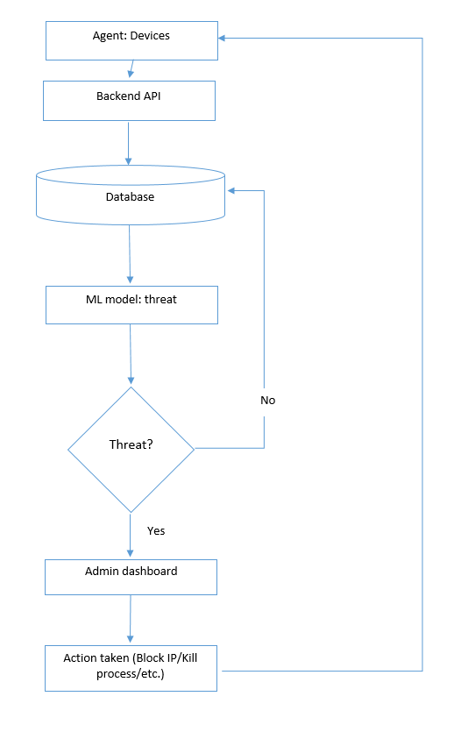
Flowchart

Slide 13
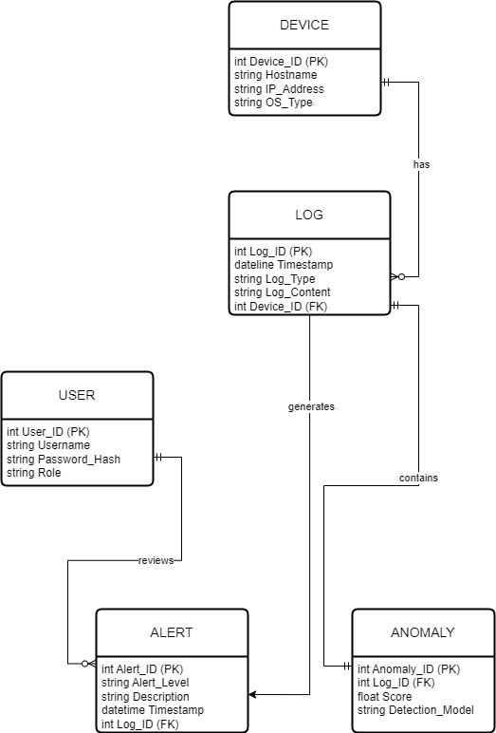
ER Diagram

Slide 14
Timeline / Work Plan

Slide 15
References
• Yadav, A. K. (2020). Unsupervised Machine Learning for Anomaly Detection in Cybersecurity. Journal of Computer Science and Technology, 38(2), 105–112
Abdullahi, M., Baashar, Y., Alhussian, H., Alwadain, A., Aziz, N., Capretz, L. F., & Abdulkadir, S. J. (2022). Detecting cybersecurity attacks in Internet of Things Using Artificial intelligence Methods: A Systematic Literature review. Electronics, 11(2), 198. https://doi.org/10.3390/electronics11020198
Kocyigit, E., Korkmaz, M., Sahingoz, O. K., & Diri, B. (2021). Real-Time Content-Based Cyber Threat Detection with Machine Learning. In Advances in intelligent systems and computing (pp. 1394–1403). https://doi.org/10.1007/978-3-030-71187-0_129

Slide 16
Thank You!

